Slide 1




NEXT GEN EMPLOYABILITY PROGRAM
Creating a future-ready workforce
Team Members
College Name
Student Name :Nishanthini R
Student ID : 950821104030
GCE, Tirunelveli

Slide 2

CAPSTONE PROJECT SHOWCASE
Voting Application using Django Framework
Notes Sharing Web Application using Django Framework
Abstract | Problem Statement | Project Overview | Proposed Solution | Technology Used | Modelling & Results | Conclusion

Slide 3
ABSTRACT: In the contemporary digital age, the integration of technology into various aspects of life has become inevitable, including the electoral process. This project proposes the development of a secure voting application using the Django framework, a high-level Python web framework known for its simplicity and robustness. The voting application aims to provide a convenient, efficient, and secure platform for conducting elections while ensuring the integrity and confidentiality of the voting process. Key features of the proposed application include user authentication, candidate profiles, ballot creation, voting mechanism, and result tabulation.
Source :

Slide 4
Problem Statement In the modern era, traditional voting systems face numerous challenges, including logistical inefficiencies, susceptibility to fraud, and limited accessibility. As technology advances, there is a growing demand for innovative solutions to address these issues and enhance the democratic process. This project aims to develop a secure and user-friendly voting application using the Django framework to overcome the challenges and revolutionize the electoral experience: 1. Security Concerns 2. Accessibility and Convenience 3. Verification and Authentication 4. Transparency and Auditability 5. User Experience
Source :

Slide 5
Project Overview: The project aims to develop a secure voting application using the Django framework, focusing on modernizing the voting process while enhancing security and accessibility. We'll start by gathering requirements to understand the needs and expectations of stakeholders. Using Django's MVC architecture, we'll design a scalable and secure system architecture. Security implementation will include encryption for user authentication and ensuring the secure transmission and storage of votes. User authentication will be managed through Django's authentication system, while administrators will have the capability to create and manage ballots and candidates. The voting interface will be user-friendly with accessibility features for inclusivity. Result tabulation will be conducted securely, and results will be presented transparently for public scrutiny. Rigorous testing will be carried out to ensure reliability and security. Finally, the application will be deployed to a production environment with ongoing maintenance and support provided.
Source :

Slide 6
Proposed Solution
The proposed solution is to develop a modern, secure, and user-friendly voting application using the Django framework.
This solution addresses the shortcomings of traditional voting systems by implementing advanced security measures, intuitive user interfaces, and robust authentication mechanisms.
Using Django's MVC architecture, the application will be designed with scalability and security in mind.
Security measures will include encryption for user authentication, secure transmission, and storage of votes to prevent tampering and ensure the integrity of the electoral process.
User authentication will be managed through Django's built-in authentication system, allowing for secure verification of voters' identities and access control based on roles and permissions.
Administrators will have the ability to create and manage ballots and candidate profiles through an intuitive interface.
Source :

Slide 7
Voters will experience a user-friendly interface that guides them through the voting process with accessibility features to accommodate users with disabilities.
Vote tabulation will be conducted securely, ensuring the anonymity of individual votes while presenting results transparently for public scrutiny.
Rigorous testing will be carried out at each stage of development to ensure reliability, security, and usability.
Once development is complete, the application will be deployed to a production environment, with ongoing maintenance and support provided to address any issues and ensure the continued smooth operation of the voting application.
Overall, the proposed solution aims to revolutionize the electoral process by providing a secure, accessible, and user-friendly platform that promotes democratic values and fosters greater civic engagement.
Source :

Slide 8


Technology Used
Front-end
Back-end
Source :

Slide 9
Modelling & Results Modelling: 1. User Model 2. Candidate Model 3. Ballot Model 4. Vote Model 5. Result Model Results: 1. User Authentication 2. Ballot Creation and Management 3. Voting Mechanism 4. Vote Tabulation 5. Security
Source :

Slide 10
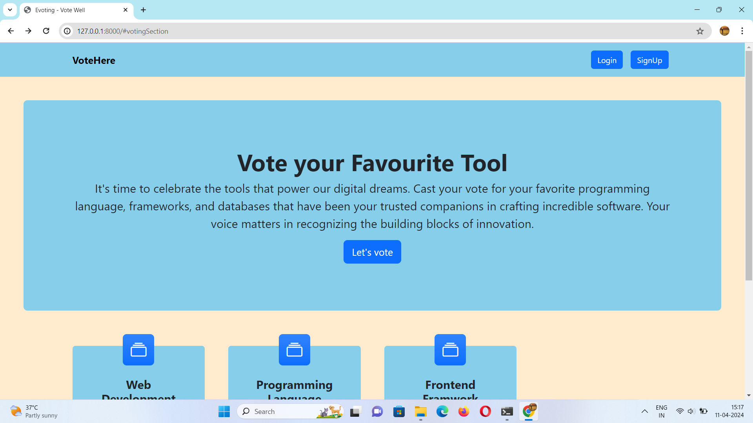
Homepage

Slide 11
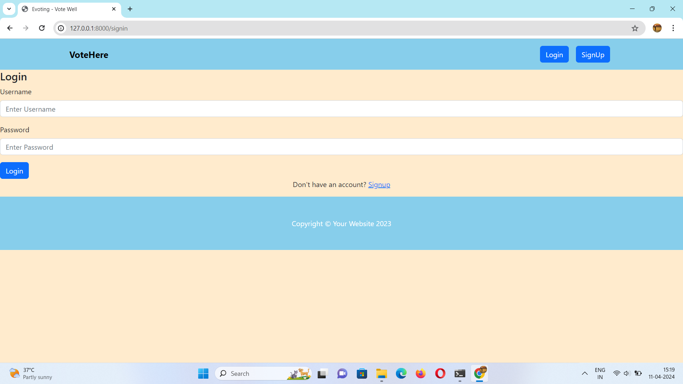
Login page

Slide 12
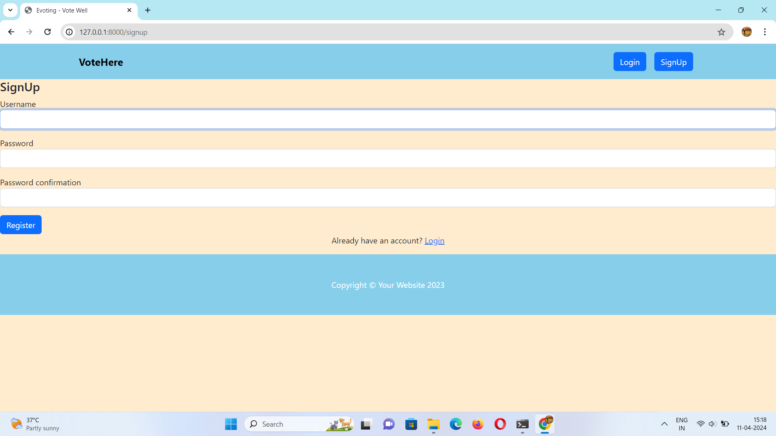
Sign-up page

Slide 13
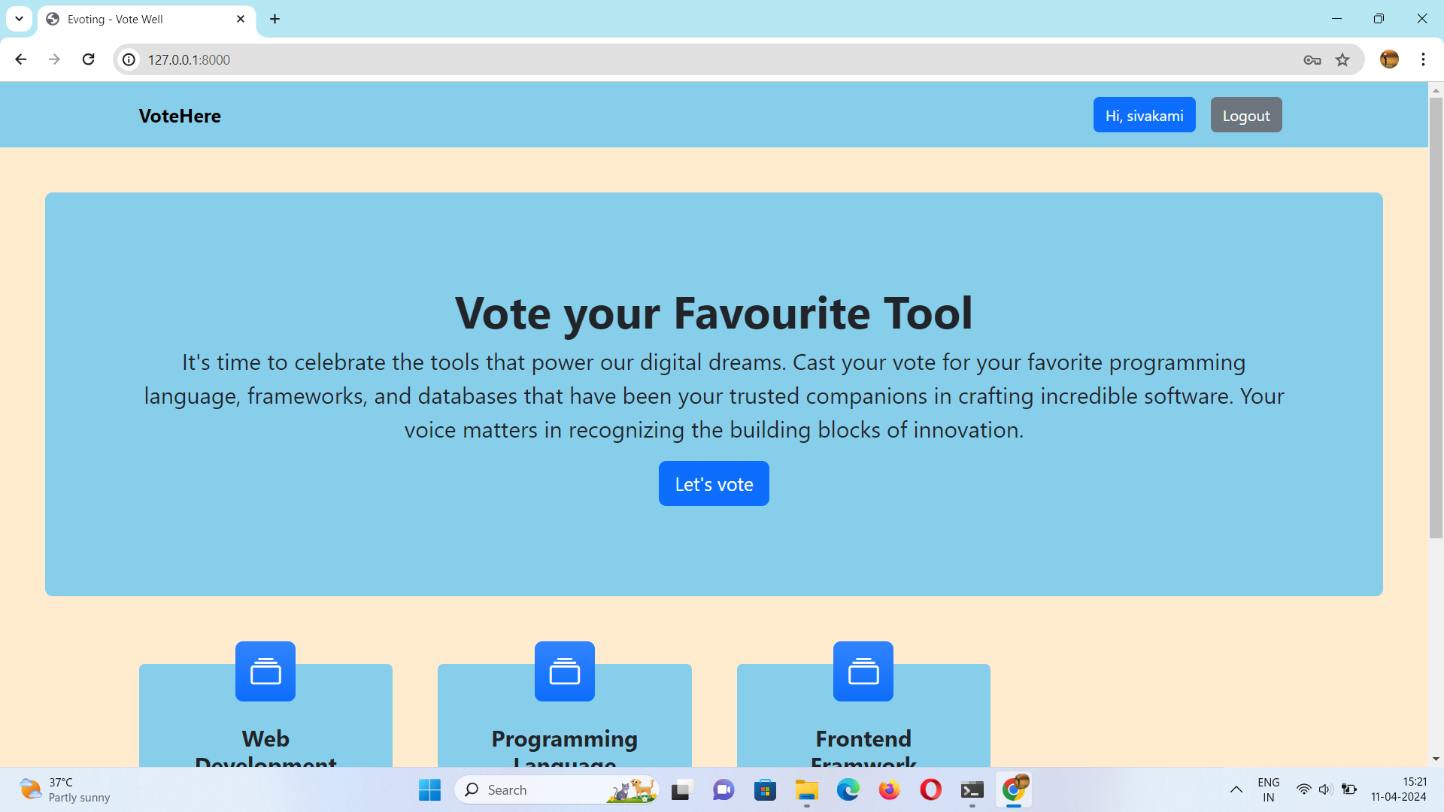
Voting page

Slide 14
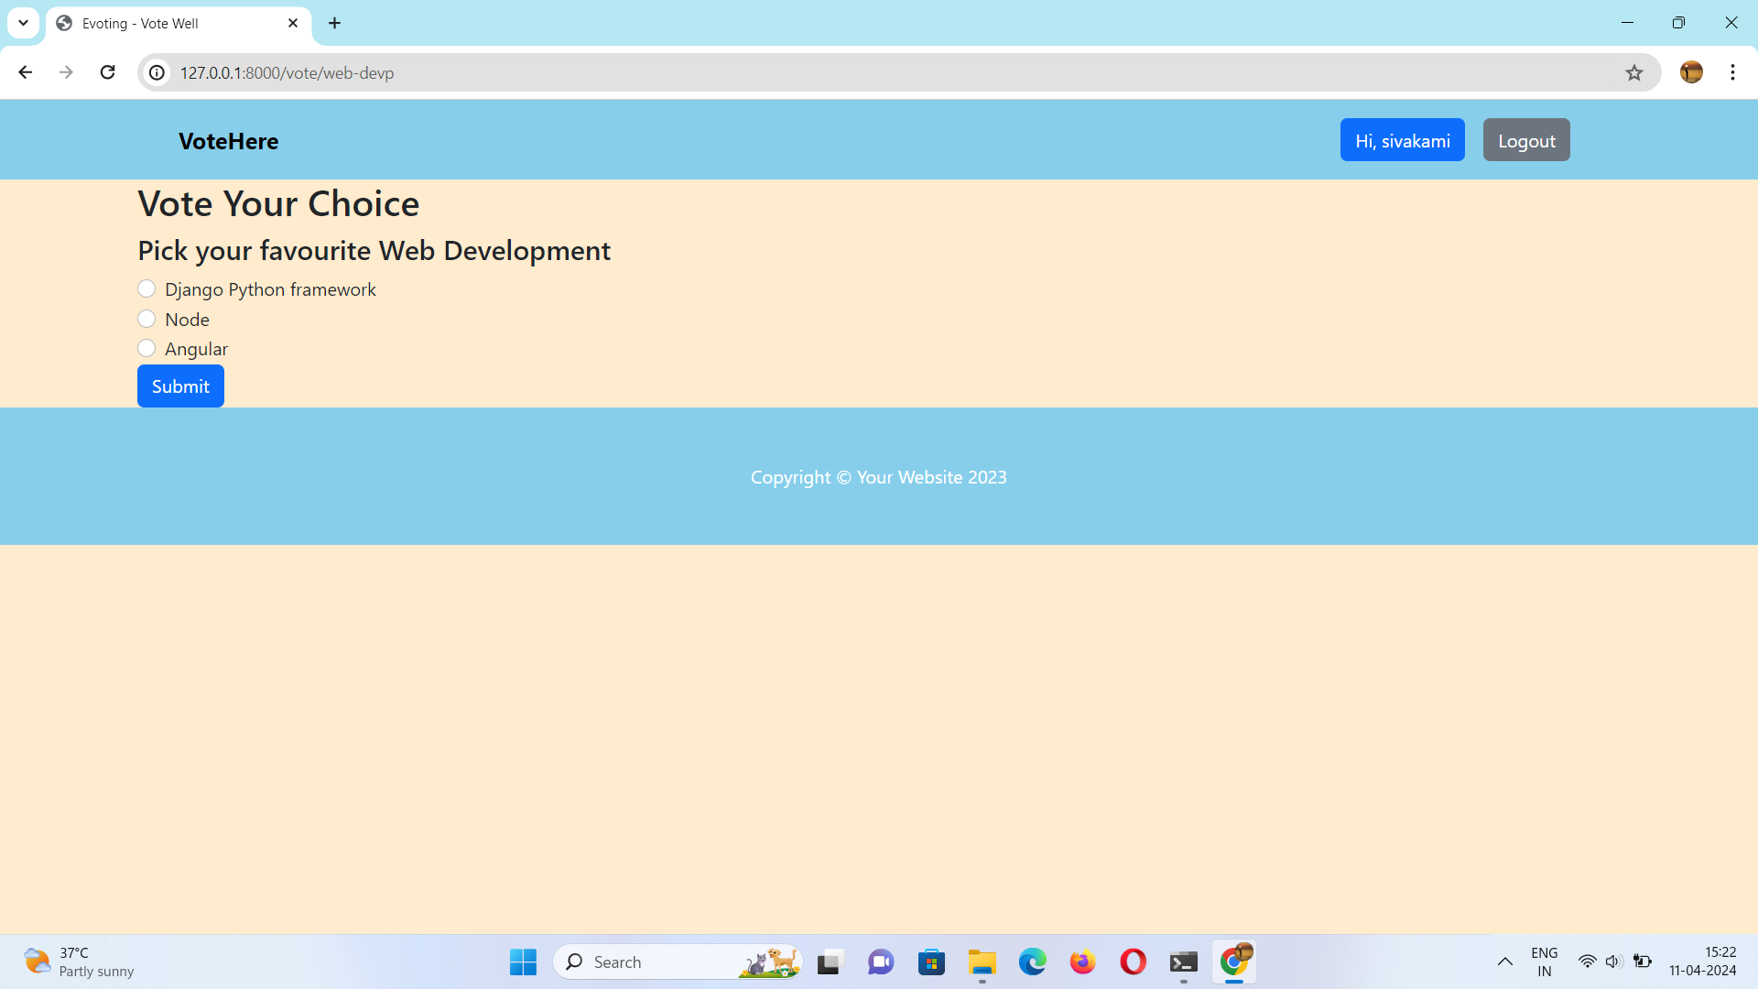
Poll page

Slide 15
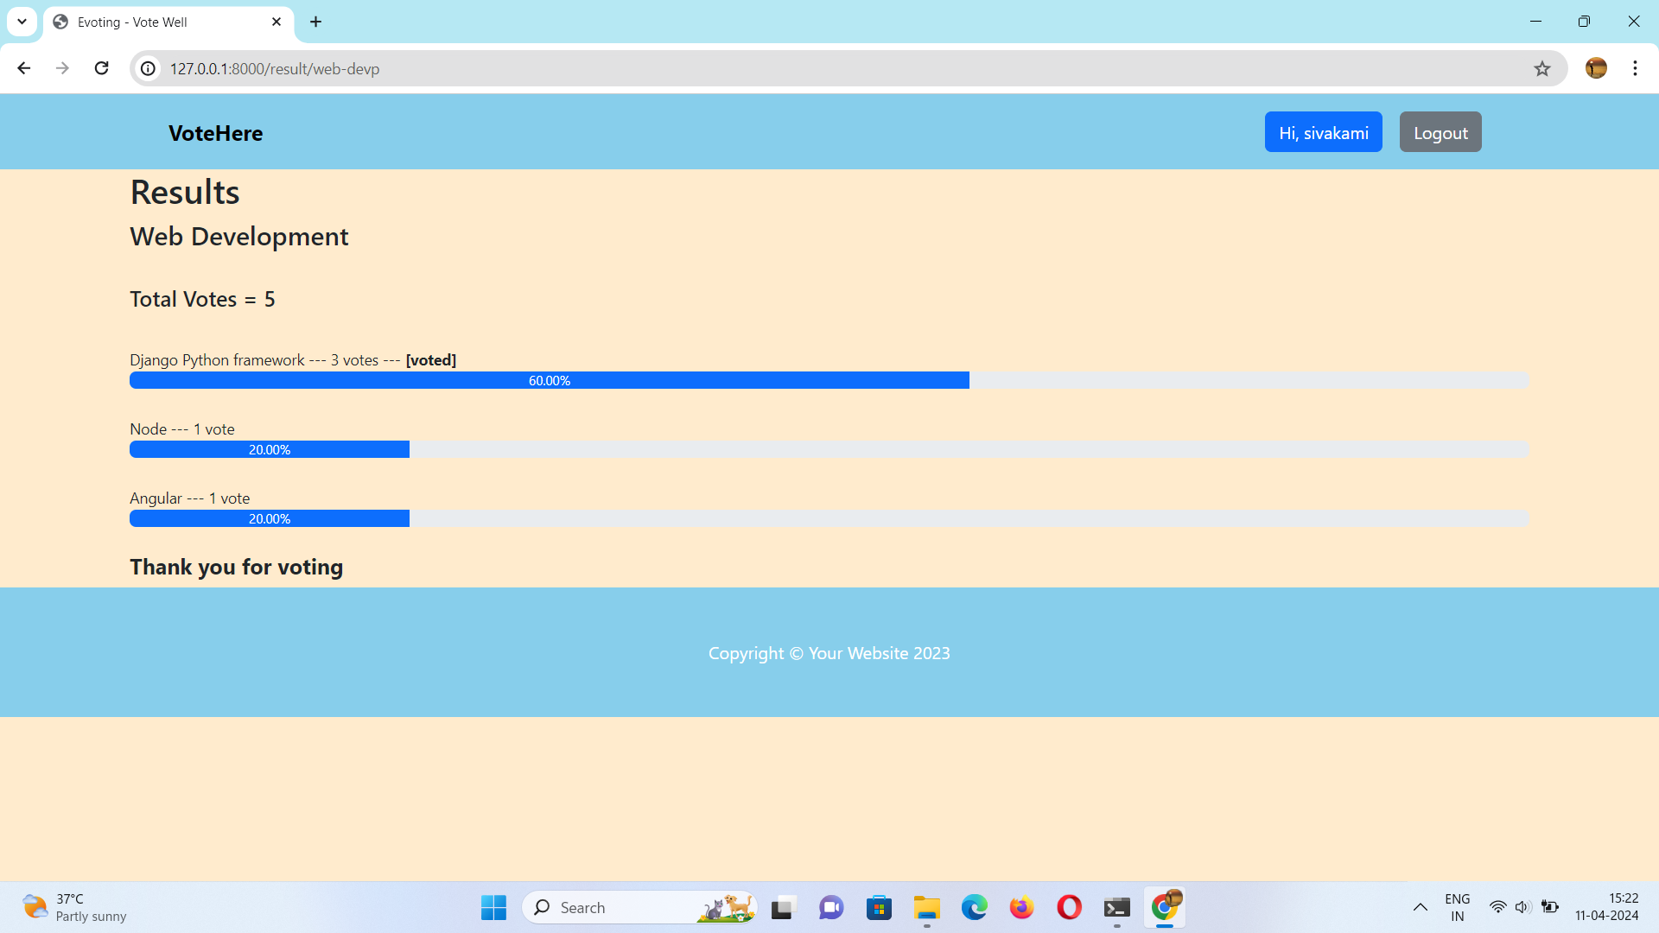
Poll Result Page

Slide 16
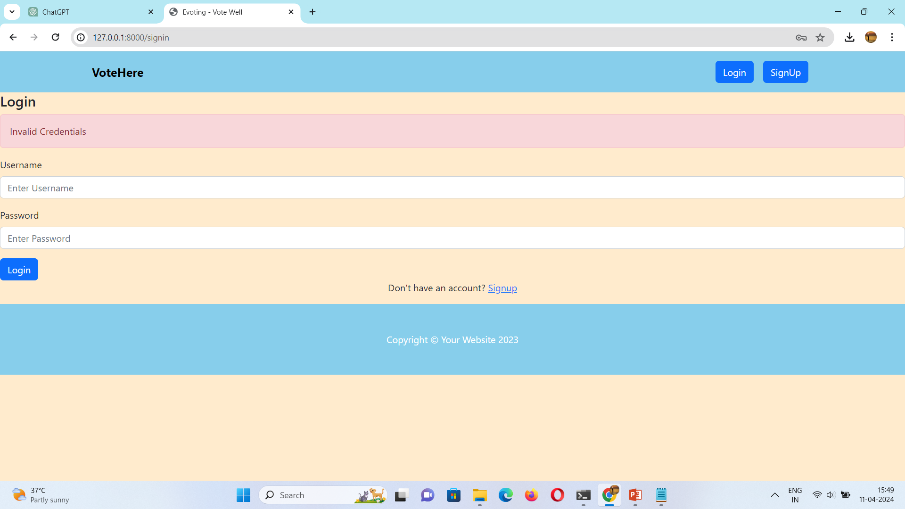
Invalid login page

Slide 17
Future Enhancements:
Future enhancements for the Django-based voting application may include blockchain integration for transparency, multi-factor authentication for heightened security, and development of a mobile application for increased accessibility.
Advanced reporting and analytics features can offer insights into voting patterns, while ranked choice voting adds nuance to the electoral process.
Continuous improvements to accessibility, real-time result updates, and integration with government systems enhance usability and accuracy. Internationalization efforts ensure the application's adaptability to diverse contexts, fostering broader democratic participation.

Slide 18
Conclusion In conclusion, the development of the voting application using the Django framework represents a significant step towards modernizing the electoral process. Through robust security measures, intuitive user interfaces, and transparent result tabulation, the application promotes trust, accessibility, and democratic participation. By leveraging Django's versatility and scalability, the project has created a platform that not only meets current needs but also lays the groundwork for future enhancements, such as blockchain integration and mobile accessibility. Ultimately, this project underscores the potential of technology to strengthen democratic values and empower citizens to engage meaningfully in the democratic process. With ongoing maintenance and support, the voting application stands ready to serve as a cornerstone of fair, transparent, and inclusive elections for years to come.
Source :

Slide 19
Thank You!
Notes:
Thank You !!

